Slide 1
SDLC MODELS-Task-2
Divya-mettu

Slide 2

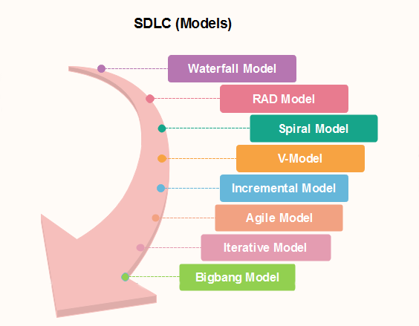
SDLC MODELS

Slide 3
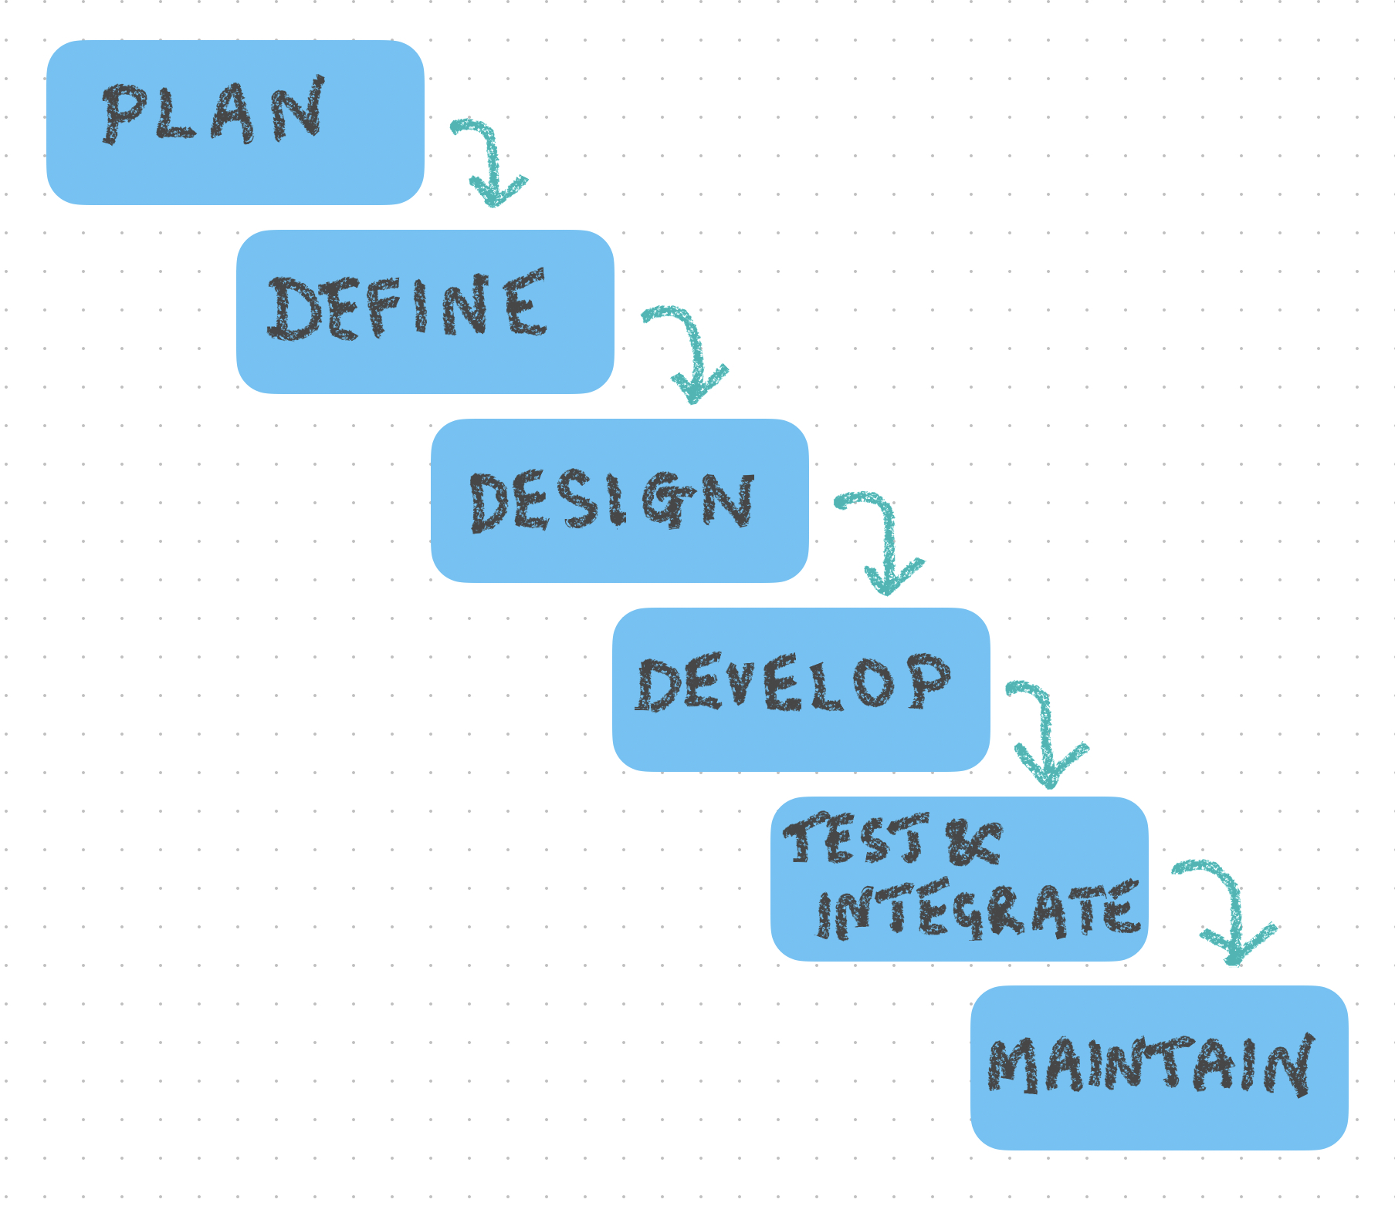
WATERFALL MODEL

Slide 4
EXAMPLES
Human resource management
Supply chain management system
Customer relationship management
Retail chains

Slide 5
Pros
cons
The requirement should be clear.
It is suitable for a smaller project
This model is easy to understand, as well as easy to use
It will allow us to arrange the tasks efficiently.
This model has no parallel deliverable
waterfall model doesn't provide the requirement changes and requirement review.
Backward tracking is not possible
It is a time-consuming process.

Slide 6
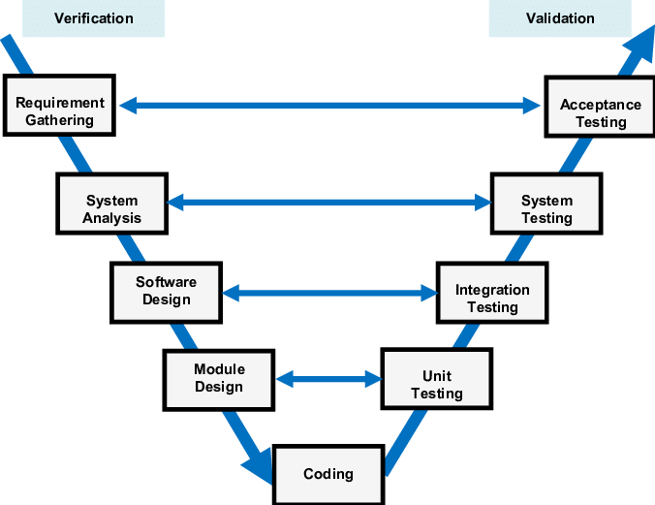
V Model

Slide 7
EXAMPLES
Hospital management system
E learning platform
Travel booking system
Inventory management system

Slide 8
Pros
cons
Review exists in every phase
The V model provides the Parallel deliverable
This model helps to deliver Robust or stable products.
the test Engineers have more knowledge about the product because testing is involved in every stage of product development.
It is a bit expensive process because Initial investment is high as the testing team is needed from the beginning
The V model is not suitable for object-oriented projects.
We cannot go back and replace the functionality once the application is in the testing phase.

Slide 9
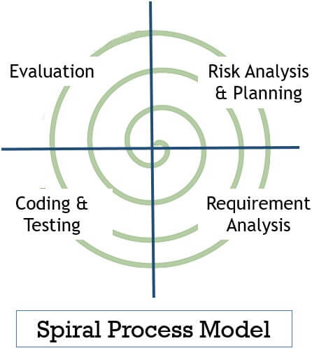
Spiral Model

Slide 10
EXAMPLES
Software development for autonomous vehicles
Health care information system
Financial trading system
Space exploration system.

Slide 11
Pros
Cons
Flexible changes are allowed in spiral mode
The development can be distributed into smaller parts.
The customer can use the application at an early stage also.
More clarity for Developers and Test engineers
It is not suitable for the small and low-risk product
It is a traditional model, and thus developers only did the testing job as well.
There is no requirement of review process and no parallel deliverables allowed in the spiral model
The maximum number of intermediate phases needs unnecessary paperwork.

Slide 12
THANK YOU
Divya.Mettu
divya.m@technovert.com

